Slide 1
Lab 5
Conceptual scheme transformation into ER

Slide 2
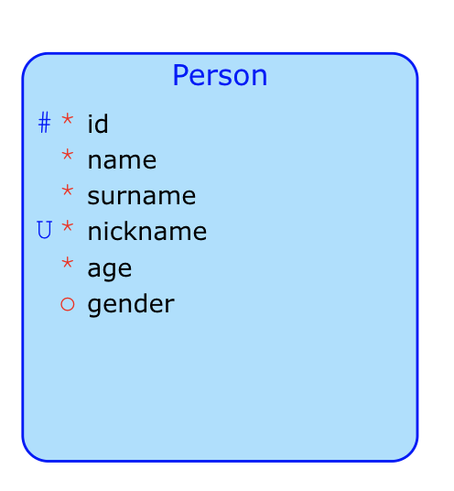
Transform next entities
Person:
Id (PK), Name (mandatory), Surname (mandatory), NickName (Unique), Age (NotNull), Gender (not mandatory)
Relational written form solution:
Person(Id, Name, NickName, Age, Gender)
Conceptual model

Slide 3
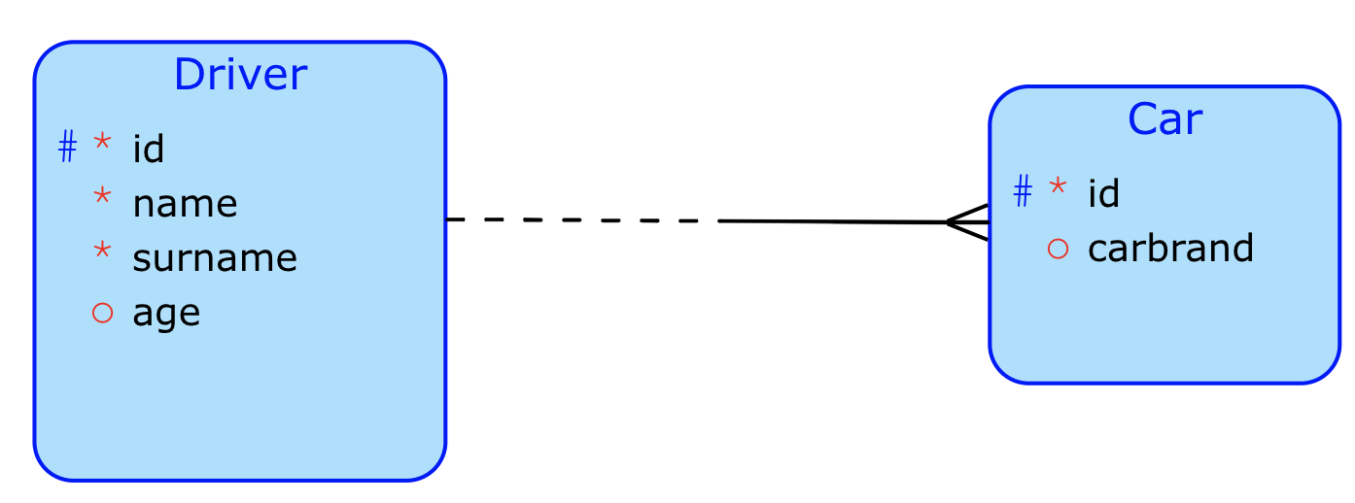
Transform next entities
One Driver has more cars. That is 1:N relationship. The Driver ID must be as foreign key placed into Car entity
Driver and Car:
Driver has:
Id (PK), Name (mandatory), Surname (mandatory), Age (Nullable)
Car has:
Id (PK), CarBrand (Nullable)
One driver can drive one or more cars. There can exists the drivers without cars. If car exist, must exist the driver.
Relational written form solution:
Driver(Id, Name, Surname,Age)
Car(Id,CarBrand,driver_id)
Car[ID]⊆Driver[ID]

Slide 4
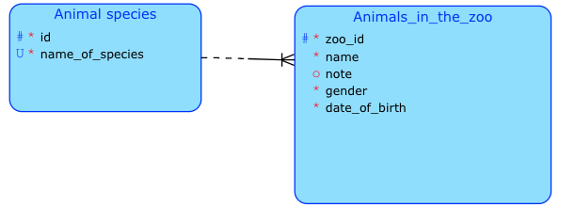
Transform next conceptual schema
If AnimalinTheZoo is a weak entity of AnimalSpecies, that must inherit the primary key ID from AnimalSpecies
AnimalSpecies(id,name_of_species)
AnimalInTheZoo(zoo_id,name,note,gender,date_of_birth,id)
AnimalInTheZoo[id]⊆AnimalSpecies[id]

Slide 5
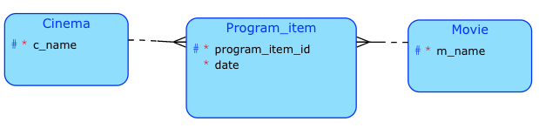
Transform next conceptual schema
Cinema(c_name)
Movie(m_name)
Program_item(program_item_id,date,c_name,m_name)
Program_item[c_name]⊆Cinema[c_name]
Program_item[m_name]⊆Movie[m_name]

Slide 6
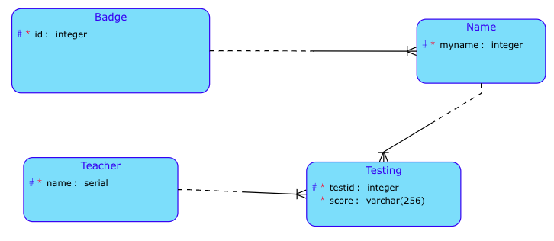
Transform next conceptual schema
Badge(id)
Name(myname,id)
Name[id] ⊆Badge[id]
Teacher(name)
Testing(testid,score,id,myname,name)
Testing[name]⊆Teacher[name]
Testing[id,myname] ⊆Name[id,myname]

